Slide 1
Linear Programming and Parameterized Algorithms

Slide 2
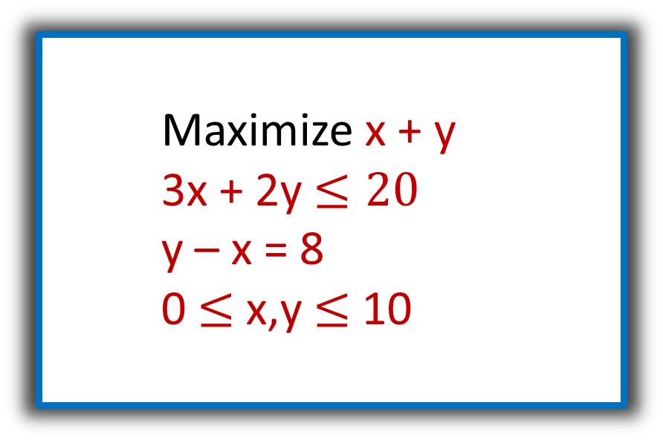
Linear Programming
n real-valued variables, x₁, x₂, … , x_{n}.
Linear objective function.
Linear (in)equality constraints.
Solvable in polynomial time.
Maximize x + y
3x + 2y $≤20$
y – x = 8
0 $≤$ x,y $≤$ 10

Slide 3
Integer Linear Programming
n integer-valued variables, x₁, x₂, … , x_{n}.
Linear objective function.
Linear (in)equality constraints.
NP-complete.
Lingo:
Linear Programs (LP’s),
Integer Linear Programs (ILP’s)
Easy to encode 3-SAT (Exercise!)

Slide 4
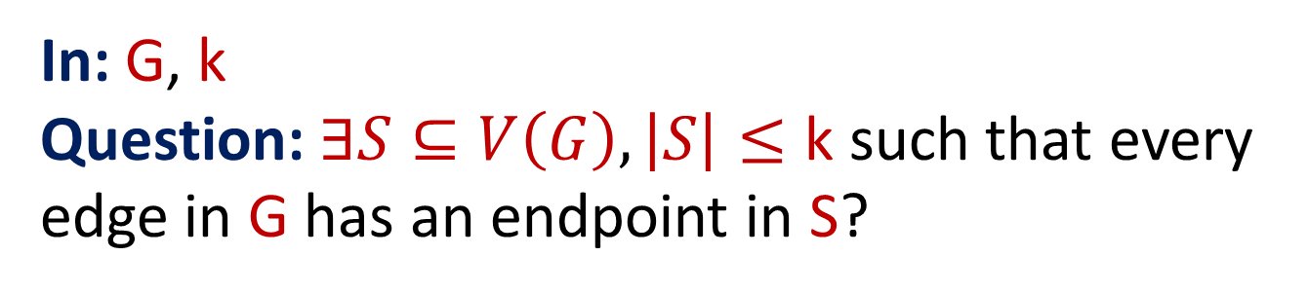
Vertex Cover
In: G, k
Question: $∃S⊆V\left(G\right), \left|S\right|≤\text{k}$such that every edge in G has an endpoint in S?
Have seen a kernel with O(k²) vertices,
will see a kernel with 2k vertices.

Slide 5
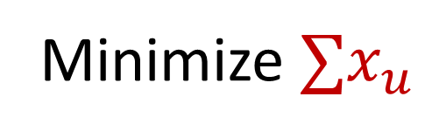
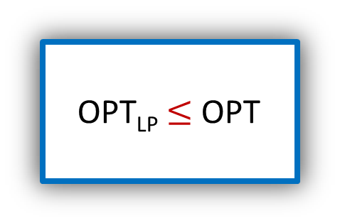
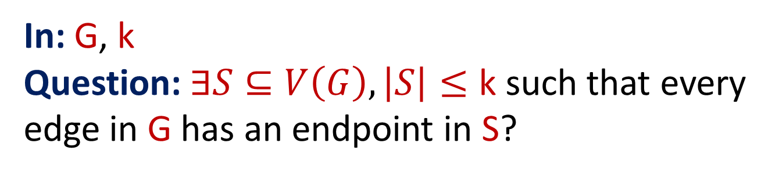
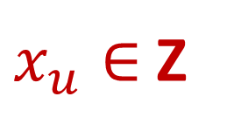
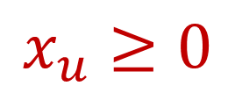
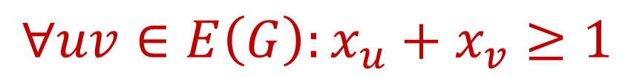
Vertex Cover (I)LP
In: G, k
Question: $∃S⊆V\left(G\right), \left|S\right|≤\text{k}$ such that every edge in G has an endpoint in S?
Minimize $∑x_{u}$
$$∀uv∈E\left(G\right):x_{u}+x_{v}≥1$$
$$x_{u}≥0$$
$x_{u}∈$ Z
OPT_{LP} $≤$ OPT

Slide 6
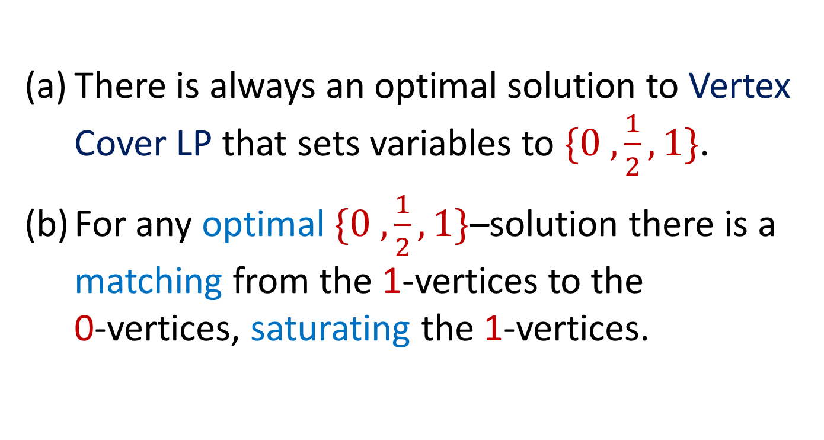
Nemhauser Trotter Theorem
There is always an optimal solution to Vertex Cover LP that sets variables to $\{0 ,\frac{1}{2}, 1\}$.
For any optimal $\{0 ,\frac{1}{2}, 1\}$–solution there is a matching from the 1-vertices to the
0-vertices, saturating the 1-vertices.

Slide 7
Matchings and Hall Sets
A matching in a graph is a set of edges that do not share any endpoints.
A matching saturates a vertex set S if every vertex in S is incident to a matching edge.
A vertex set S is a Hall set if it is independent and |N(S)| < |S|.
A Hall set may never be saturated!

Slide 8
Hall’s Theorem
Theorem: A bipartite graph has a matching such that every left hand side vertex is saturated
⇔
there is no Hall set on the left hand side.

Slide 9
Hall’s Theorem Example
Matching
(so no Hall set)
Hall set
(so no matching)

Slide 10
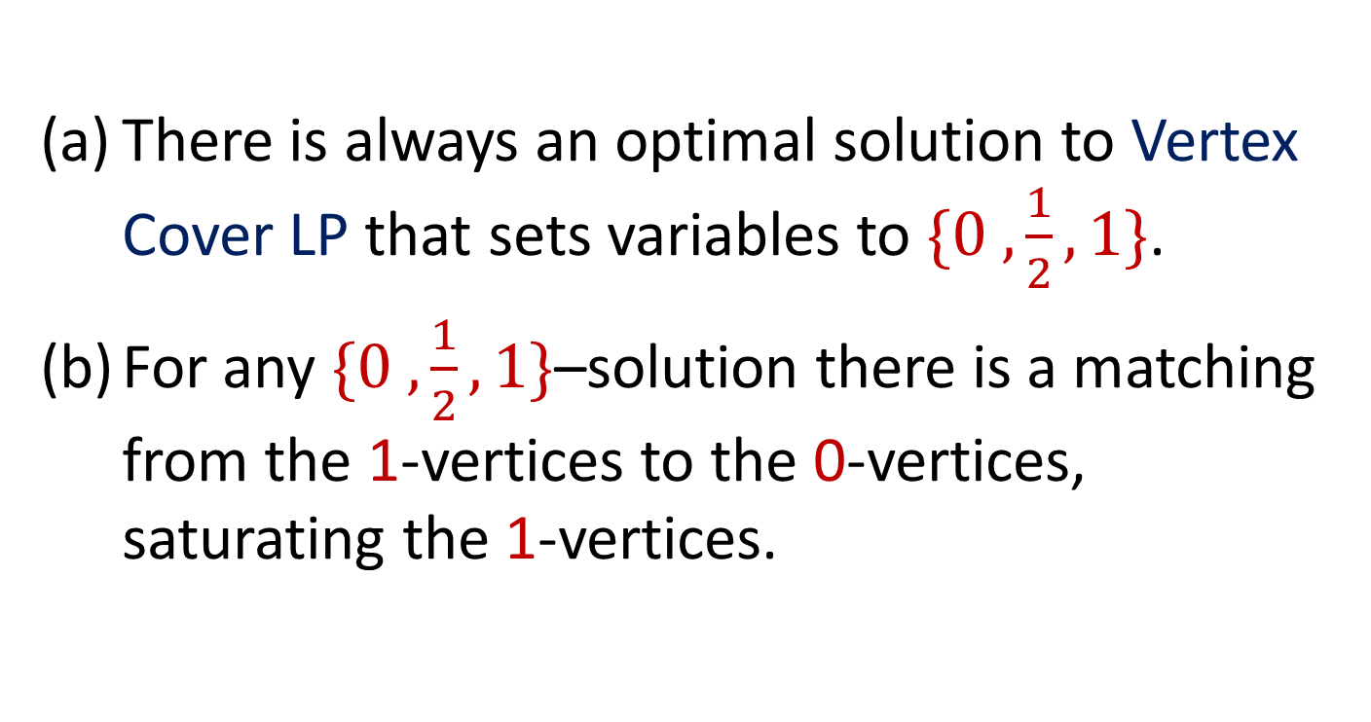
Nemhauser Trotter Theorem
There is always an optimal solution to Vertex Cover LP that sets variables to $\{0 ,\frac{1}{2}, 1\}$.
For any $\{0 ,\frac{1}{2}, 1\}$–solution there is a matching from the 1-vertices to the 0-vertices, saturating the 1-vertices.

Slide 11

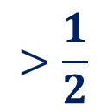

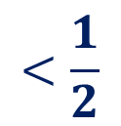






Nemhauser Trotter Proof
Right
$$<\frac{1}{2}$$
+$ϵ$
+$ϵ$
$$0$$
$$>\frac{1}{2}$$
Left
-$ϵ$
-$ϵ$
-$ϵ$
$$1$$
This clearly proves (a),
but why does it prove (b)?
$$\frac{1}{2}$$

Slide 12
Reduction Rule
If exists optimal LP solution that sets x_{v} to 1, then exists optimal vertex cover that selects v.
Remove v from G and decrease k by 1.
Correctness follows from Nemhauser Trotter
Polynomial time by LP solving.

Slide 13
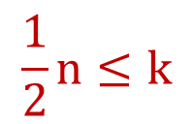
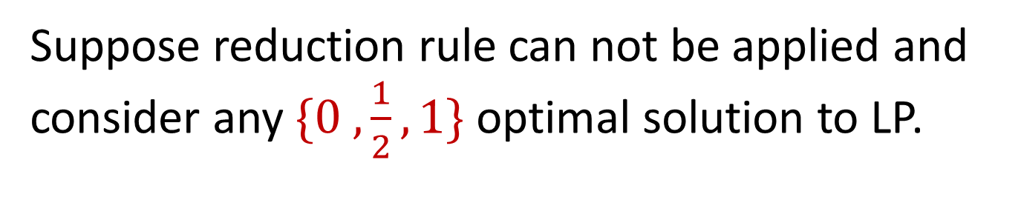
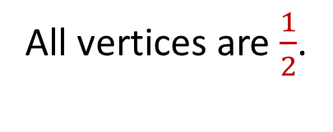
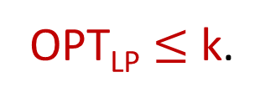
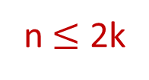
Kernel
Suppose reduction rule can not be applied and consider any $\{0 ,\frac{1}{2}, 1\}$ optimal solution to LP.
No vertex is 0
(remove isolated vertices)
No vertex is 1.
All vertices are $\frac{1}{2}$.
OPT_{LP} $≤$k.
$$\frac{1}{2}n≤k$$
n $≤$ 2k

Slide 14

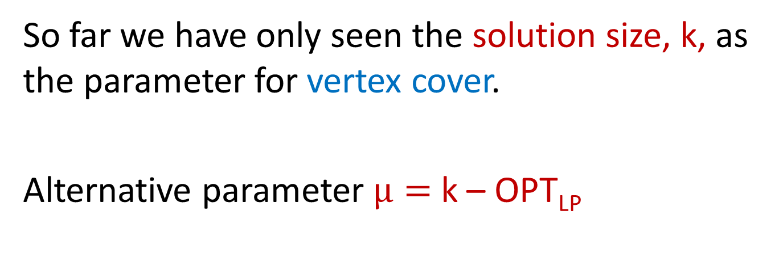
Above LP Vertex Cover
So far we have only seen the solution size, k, as the parameter for vertex cover.
Alternative parameter $μ=$ k – OPT_{LP}
Note that $μ$ can be very small even if k is big!

Slide 15

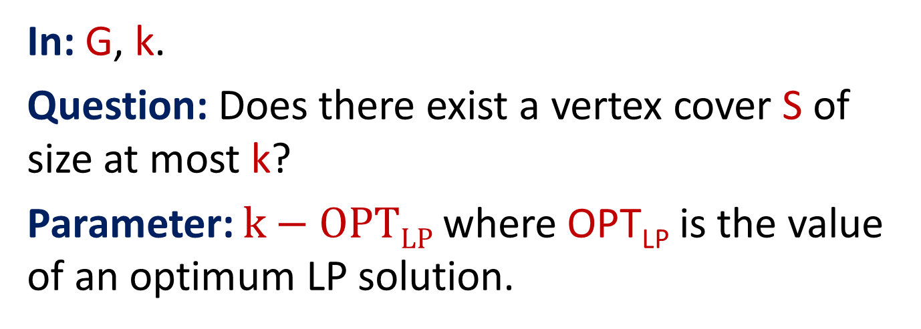
Vertex Cover Above LP
In: G, k.
Question: Does there exist a vertex cover S of size at most k?
Parameter: $k−OPTLP$ where OPT_{LP} is the value of an optimum LP solution.
Now FPT means f($k−{OPT}_{LP}$)n^{c} time!

Slide 16
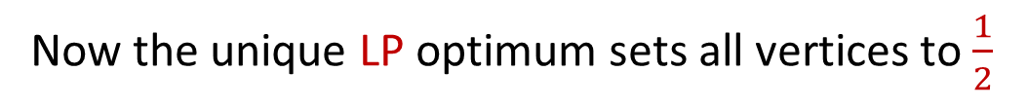
Reduction Rule
Recall the reduction rules from the kernel for Vertex Cover:
  If exists optimal LP solution that sets x_{v} to 1, then exists optimal vertex cover that selects v.
  Remove v from G and decrease k by 1.
  Remove vertices of degree 0.
Now the unique LP optimum sets all vertices to $\frac{1}{2}$

Slide 17
Reduction affects k-OPT_{LP}?
Reduction rule: If exists optimal LP solution that sets x_{v} to 1 → Remove v and decrease k by 1.
OPT_{LP} decreases by exactly 1. Why?
Feasible LP Solution
to G\u
1
v
k-OPT_{LP} is unchanged!

Slide 18
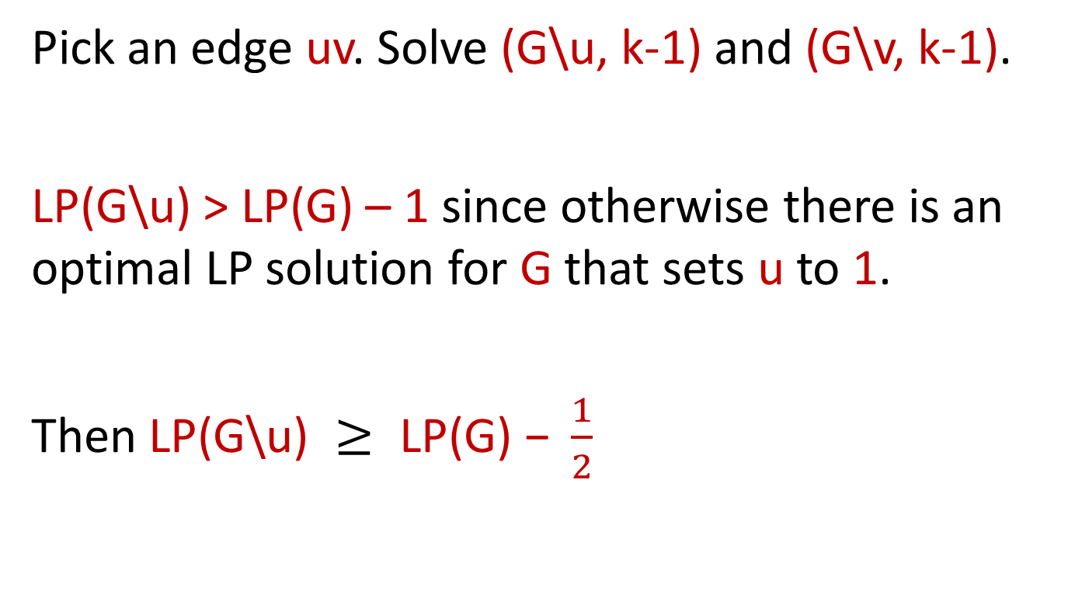
Branching
Pick an edge uv. Solve (G\u, k-1) and (G\v, k-1).
$\text{LP}\text{(}\text{G}\text{\backslash }\text{u}\text{) > }\text{LP}\text{(}\text{G}\text{) – 1}$ since otherwise there is an optimal LP solution for G that sets u to 1.
Then $\text{LP}\text{(}\text{G}\text{\backslash }\text{u}\text{) }≥ \text{LP}\text{(}\text{G}\text{) − }\frac{1}{2}$

Slide 19
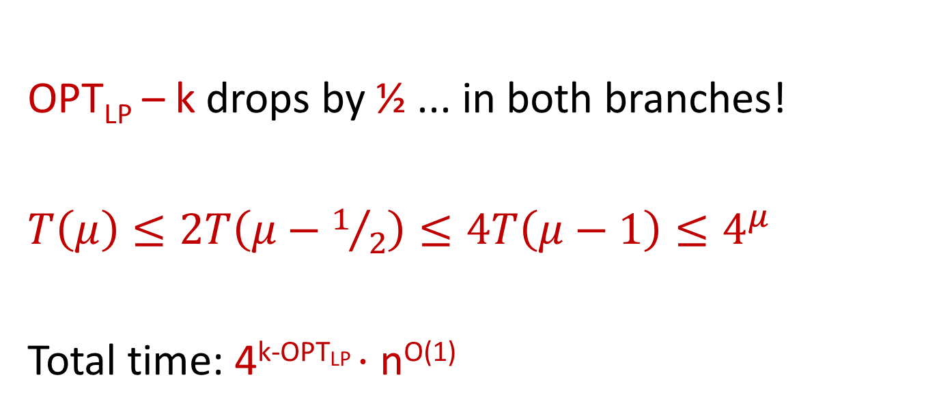
Branching - Analysis
OPT_{LP} – k drops by ½ ... in both branches!
$T\left(μ\right)≤2T\left(μ−1/2\right)≤{4T\left(μ−1\right)≤4}^{μ}$
Total time: 4^{k-OPTLP} $⋅$ n^{O(1)}

Slide 20
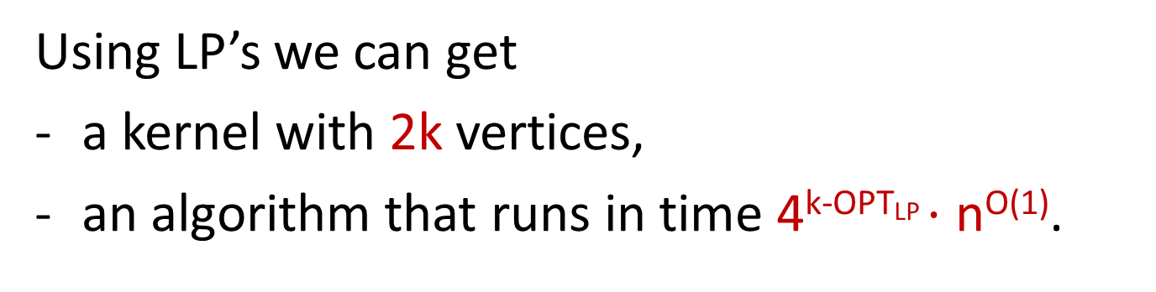
Vertex Cover recap
Using LP’s we can get
a kernel with 2k vertices,
an algorithm that runs in time 4^{k-OPTLP} $⋅$ n^{O(1)}.
Is this useful when compared to a 1.38^{k} algorithm?

Slide 21

Almost 2-SAT
In: 2-SAT formula$ψ$, integer k
Question: Can we remove* k variables from $ψ$ and make it satisfiable?
*Remove all clauses that contain the variable
Notes:
Exercise: variables vs clauses

Slide 22
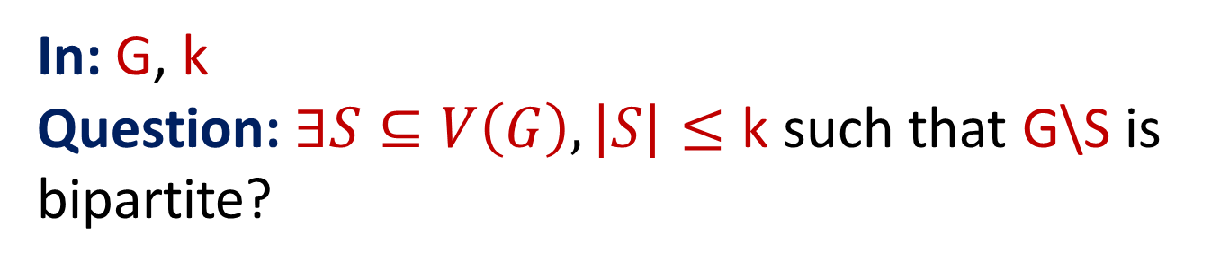
Odd Cycle Transversal (OCT)
In: G, k
Question: $∃S⊆V\left(G\right), \left|S\right|≤\text{k}$ such that G\S is bipartite?
Will give algorithms for Almost 2-SAT and OCT,
using FPT-reductions to Vertex Cover above LP!

Slide 23






Odd Cycle Transversal
→ Almost 2-Sat
$$x∨¬y$$
x
y
x
$$¬x∨y$$
y
$$¬x∨z$$
z
$$y∨¬z$$
$$x∨¬z$$
$$¬y∨z$$
z

Slide 24








Almost 2-SAT → Vertex Cover/k-LP
$$x∨y$$
$$x$$
$$y$$
$$z$$
$$y∨¬z$$
$$¬x$$
$$¬y$$
$$¬z$$

Slide 25
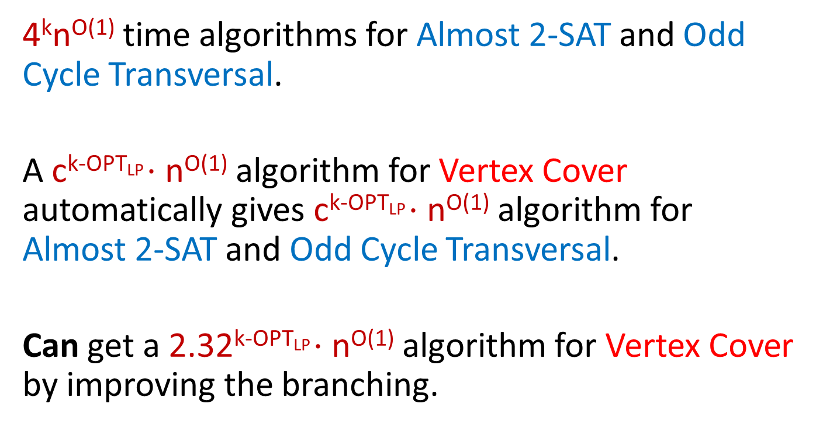
Consequences
4^{k}n^{O(1)} time algorithms for Almost 2-SAT and Odd Cycle Transversal.
A c^{k-OPTLP} $⋅$ n^{O(1)} algorithm for Vertex Cover automatically gives c^{k-OPTLP} $⋅$ n^{O(1)} algorithm for Almost 2-SAT and Odd Cycle Transversal.
Can get a 2.32^{k-OPTLP} $⋅$ n^{O(1)} algorithm for Vertex Cover by improving the branching.

Slide 26
LP versus ILP
We saw an application of LP’s in parameterized algorithms.
ILP solving is NP-hard. Useless for algorithms?
No! We can use parameterized algorithms for Integer Linear Programming.

Slide 27
Integer Linear Programming
Theorem:
k^{4.5k}poly(L) time algorithm, where k is the number of variables, and L is the number of bits encoding the instance.

Slide 28
Closest String
Input: n strings s₁…s_{n} over an alphabet A, all of same length L, and an integer k.
Question: Is there a string s such that for every i, d(s, s_{i}) $≤$ k?
Parameter: n
Note: the parameter is the number of strings, not k

Slide 29
Closest String as Hit & Miss
For every position, need to choose the letter of solution string s.
For all strings s differs from at that position, increase distance by one.
Can’t miss any string more than k times.

Slide 30
Closest String Alphabet Reduction
Can assume that alphabet size is at most n.
1111111111111111
1234123412342222
3214321443322114
1
1
2
1
2
2
1
2
1
1
2
2
111111111111
122212222222
221223232113

Slide 31
Column Types
1
1
2
1
1
2
1
1
2
1
1
2
111111111111
122212222222
221223232113
1
2
3
4
5
112
122
113
122
121

Slide 32
Closest String ILP
After alphabet reduction, there are at most n^{n} column types.
Count the number of columns of each column type.

Slide 33
ILP
For each column type, make n variables, one for each letter.
${x_{a}}^{t}$ = number of columns of type t where the
solution picks the letter a.
Constraints: For each column type t, the chosen letters add up
to the number of type t.

Slide 34
Objective Function
For a string s_{i} and column type t, let
s_{i}[t] be the letter of s_{i} in columns of type t.
For each string s_{i}, its distance from the solution string s is
$$d_{i}=\sum_{type t}{\sum_{\begin{aligned}letter \\ a≠s_{i}[t]\end{aligned}}{{x_{a}}^{t}}}$$
Objective is Minimize Max d_{i}

Slide 35
Algorithm for Closest String
Number of variables in the ILP is n$⋅$n^{n} so the final running time is FPT in n. (double exponential)

Slide 36
Conclusions
(Integer) Linear Programming is a useful tool for parameterized algorithms.
Has not yet been explored in great depth

Slide 37
Exercises
Show that ILP is NP-hard.
Show that the clause deletion version of Almost 2-SAT is FPT by reduction to Almost 2-SAT.
Book: 3.20, 3.23

Slide 38
Thank You?

Slide 39
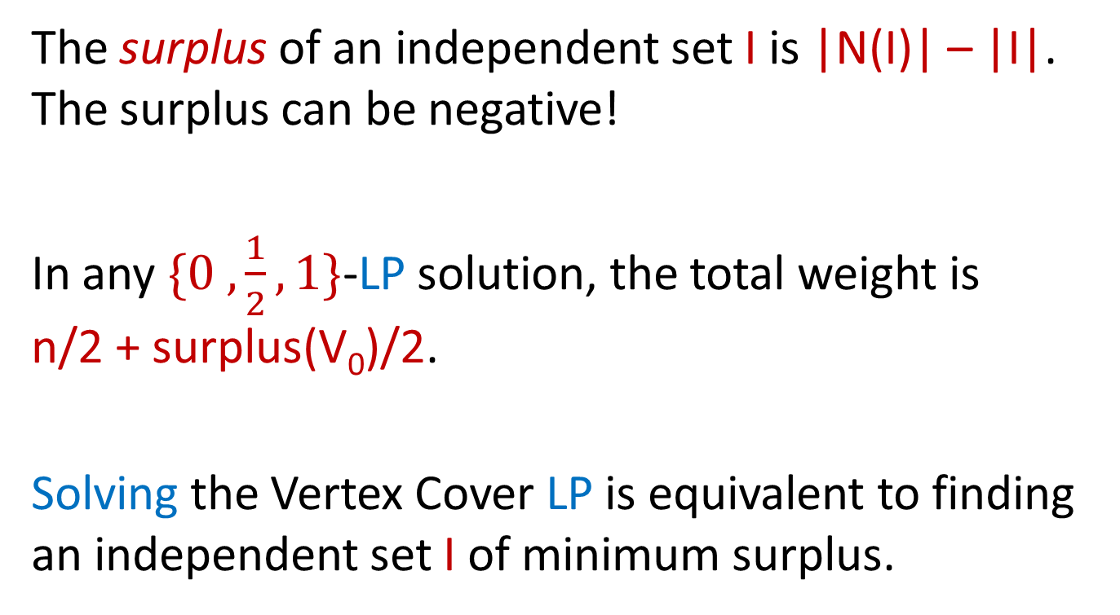
Surplus
The surplus of an independent set I is |N(I)| – |I|. The surplus can be negative!
In any $\{0 ,\frac{1}{2}, 1\}$-LP solution, the total weight is
n/2 + surplus(V₀)/2.
Solving the Vertex Cover LP is equivalent to finding an independent set I of minimum surplus.
Notes:
So finding the independent set of minimum surplus can be done using LP solving

Slide 40



Surplus
$$0$$
$$1$$
$$\frac{1}{2}$$

Slide 41
Surplus and Reductions
If «all ½» is the unique LP optimum then surplus(I) > 0 for all independent sets.
Can we say anything meaningful for independent sets of surplus 1? 2? k?

Slide 42
Surplus Branching Lemma
Let I be an independent set in G with minimum surplus. There exists an optimal vertex cover C that either contains I or avoids I.

Slide 43


Surplus Branching Lemma Proof
$I∩S$
$I∖S$
I
N(I)
R

Slide 44
Branching Rule
Find an independent set I of minimum surplus.
Branch: Either put all of I into solution, or put all of N(I) into solution.
Correct by branching lemma. Need to analyze measure drop in both branches.

Slide 45
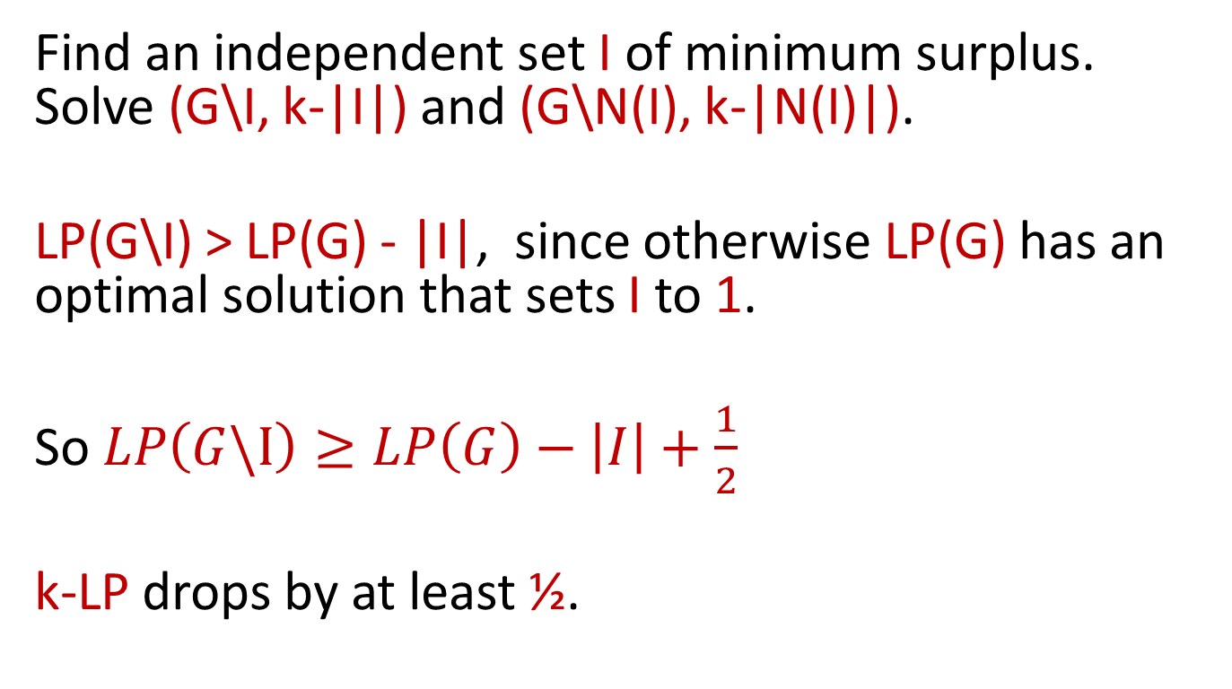
Branching Rule
Find an independent set I of minimum surplus. Solve (G\I, k-|I|) and (G\N(I), k-|N(I)|).
LP(G\I) > LP(G) - |I|, since otherwise LP(G) has an optimal solution that sets I to 1.
So $LP\left(G\backslash I\right)≥LP\left(G\right)−\left|I\right|+\frac{1}{2}$
k-LP drops by at least ½.

Slide 46
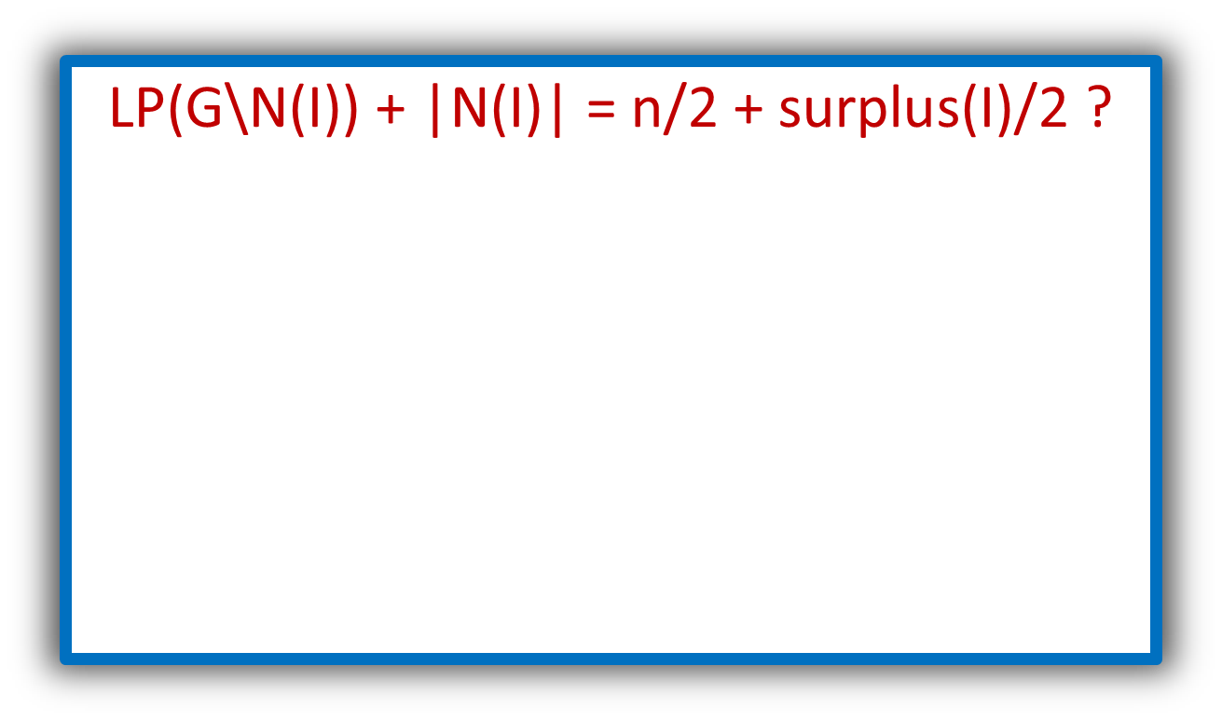
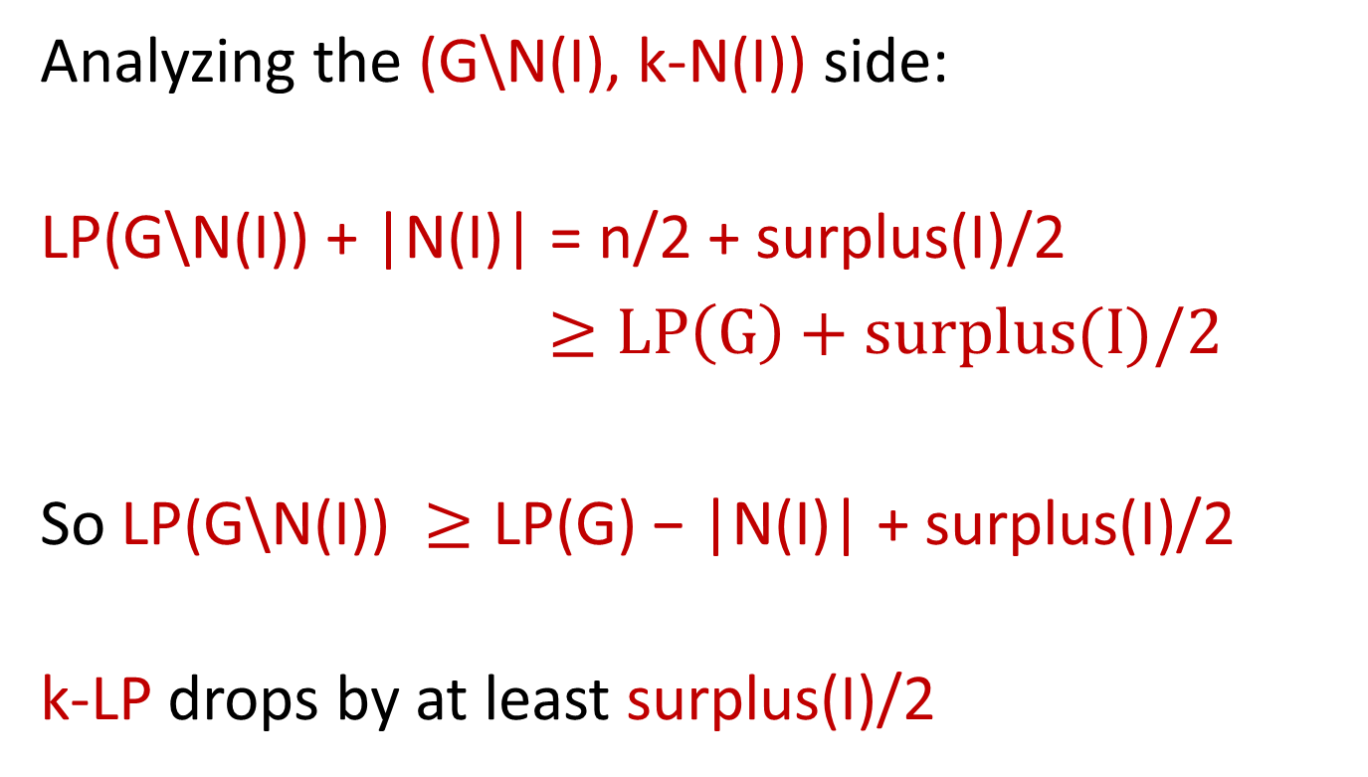

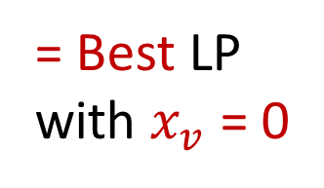
Branching Rule Analysis Cont’d
Analyzing the (G\N(I), k-N(I)) side:
$$\text{LP}\text{(}\text{G}\text{\backslash }\text{N}\text{(}\text{I}\text{)) + |}\text{N}\text{(}\text{I}\text{)| = }\text{n}\text{/2 + }\text{surplus}\text{(}\text{I}\text{)/2}$$
$≥LP\left(G\right)+surplus(I)/2$
So $\text{LP}\text{(}\text{G}\text{\backslash }\text{N}\text{(}\text{I}\text{)) }≥\text{LP}\text{(}\text{G}\text{) − |}\text{N}\text{(}\text{I}\text{)| + }\text{surplus}\text{(}\text{I}\text{)/2}$
k-LP drops by at least $\text{surplus}\text{(}\text{I}\text{)/2}$
$$\text{LP}\text{(}\text{G}\text{\backslash }\text{N}\text{(}\text{I}\text{)) + |}\text{N}\text{(}\text{I}\text{)| = }\text{n}\text{/2 + }\text{surplus}\text{(}\text{I}\text{)/2 ?}$$
= Feasible
LP with
$x_{v}$ = 0
1/2
= Best LP
with $x_{v}$ = 0
v
I
0
N(I)
1

Slide 47
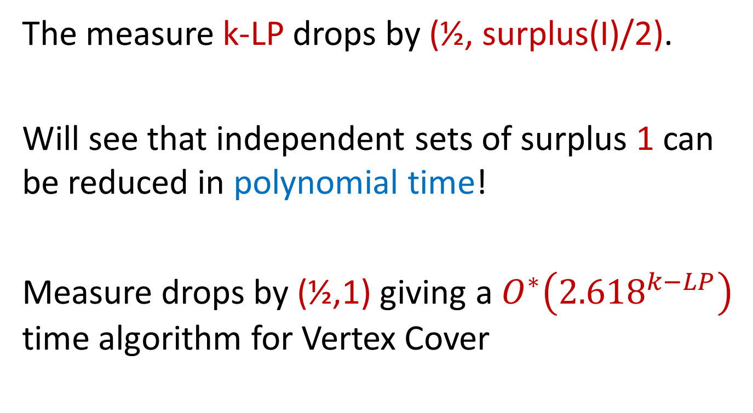
Branching Summary
The measure k-LP drops by (½, surplus(I)/2).
Will see that independent sets of surplus 1 can be reduced in polynomial time!
Measure drops by (½,1) giving a $O^{∗}\left({2.618}^{k−LP}\right)$ time algorithm for Vertex Cover

Slide 48
Reducing Surplus 1 sets.
Lemma: If surplus(I) = 1, I has minimum surplus and N(I) is not independent then there exists an optimum vertex cover containing N(I).
I
N(I)
R

Slide 49
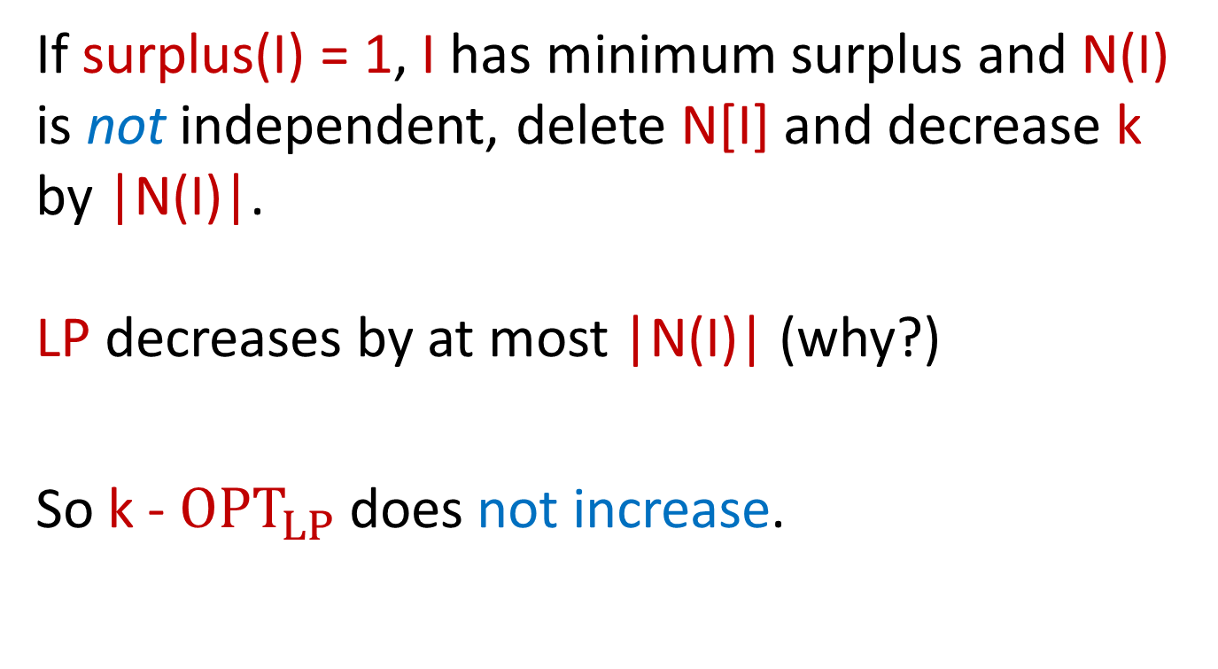
Reducing Surplus 1 Sets
If surplus(I) = 1, I has minimum surplus and N(I) is not independent, delete N[I] and decrease k by |N(I)|.
LP decreases by at most |N(I)| (why?)
So k - ${OPT}_{LP}$ does not increase.

Slide 50
Reducing Surplus 1 sets.
Reduction Rule: If surplus(I) = 1, I has minimum surplus and N(I) is independent then solve
(G’,k-|I|) where G’ is G with N[I] contracted to a single vertex v.
OPT_{LP} decreases
by at most |I|
(why?)
I
N(I)
R

Slide 51
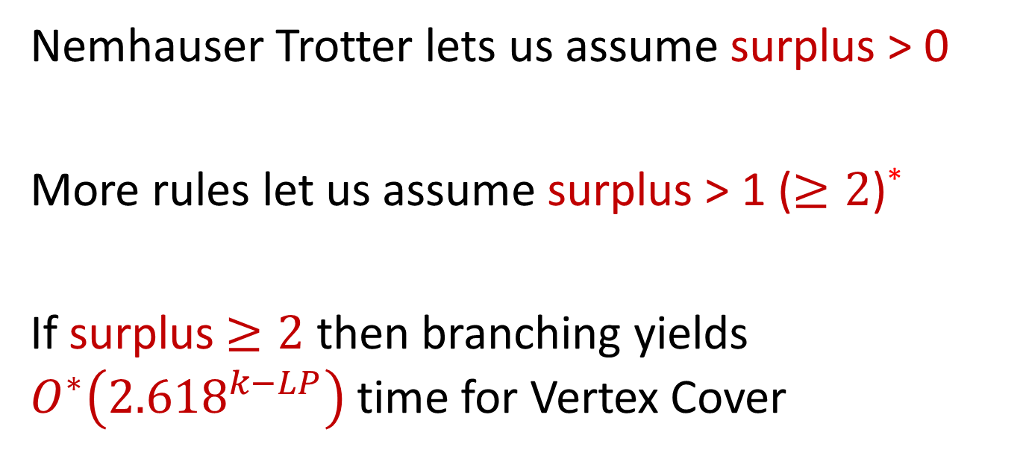
Summary
Nemhauser Trotter lets us assume surplus > 0
More rules let us assume surplus > 1 ($≥2$)*
If surplus$≥2$ then branching yields $O^{∗}\left({2.618}^{k−LP}\right)$ time for Vertex Cover
The correctness of these rules were also proved by NT!

Slide 52
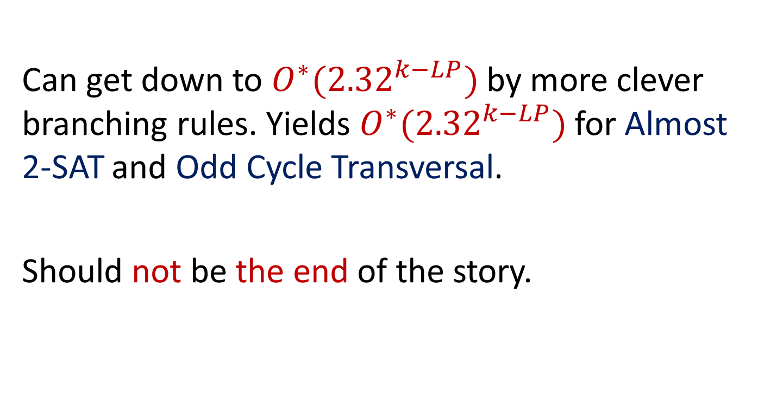
Can we do better?
Can get down to $O^{∗}({2.32}^{k−LP})$ by more clever branching rules. Yields $O^{∗}({2.32}^{k−LP})$ for Almost 2-SAT and Odd Cycle Transversal.
Should not be the end of the story.

Slide 53

Better OCT?
Can we get down to $O^{∗}(2^{k})$ for Odd Cycle Transversal?

Slide 54
LP Branching in other cases
I believe more problems should have FPT algorithms by LP-guided branching.
One example: Multiway Cut.
What about ... (Directed) Feedback Vertex Set, parameterized by solution size k?

Slide 55
Thank You!

